Slide 1
Graph-Based Algorithms
CSE 301: Combinatorial Optimization

Slide 2
All-Pairs Shortest Paths
2
Given:
Directed graph G = (V, E)
Weight function w : E → R
Compute:
The shortest paths between all pairs of vertices in a graph
Representation of the result: an n × n matrix of shortest-path distances δ(u, v)
3
4
1
8
3
2
-4
1
-5
7
5
4
6

Slide 3
Dijkstra (G, w, s)
INITIALIZE-SINGLE-SOURCE(V, s)
S ← ∅
Q ← V[G]
while Q ≠ ∅
do u ← EXTRACT-MIN(Q)
S ← S ∪ {u}
for each vertex v ∈ Adj[u]
do RELAX(u, v, w)
Running time: O(VlgV + ElgV) = O(ElgV)
Θ(V)
O(V) build min-heap
Executed O(V) times
O(lgV)
O(E) times; O(lgV)

Slide 4
BELLMAN-FORD(V, E, w, s)
INITIALIZE-SINGLE-SOURCE(V, s)
for i ← 1 to |V| - 1
do for each edge (u, v) ∈ E
do RELAX(u, v, w)
for each edge (u, v) ∈ E
do if d[v] > d[u] + w(u, v)
then return FALSE
return TRUE
Running time: O(VE)
Θ(V)
O(V)
O(E)
O(VE)
O(E)

Slide 5
All-Pairs Shortest Paths - Solutions
Run BELLMAN-FORD once from each vertex:
O(V²E), which is O(V⁴) if the graph is dense (E = Θ(V²))
If no negative-weight edges are present, we can run Dijkstra’s algorithm once from each vertex:
O(VElgV) with binary heap, which is O(V³lgV) if the graph is dense
We can solve the problem in O(V³), with no elaborate data structures

Slide 6
All-Pairs Shortest Paths
Assume the graph (G) is given as adjacency matrix of weights
W = (w_{ij}), n x n matrix, |V| = n
Vertices numbered 1 to n
if i = j
w_{ij} = if i ≠ j , (i, j) ∈ E
if i ≠ j , (i, j) ∉ E
Output the result in an n x n matrix
D = (d_{ij}), where d_{ij} = δ(i, j)
Solve the problem using dynamic programming
2
3
4
1
8
3
0
2
-4
1
-5
weight of (i, j)
7
5
4
∞
6

Slide 7
The Floyd-Warshall Algorithm
2
Given:
Directed, weighted graph G = (V, E)
Negative-weight edges may be present
No negative-weight cycles could be present in the graph
Compute:
The shortest paths between all pairs of vertices in a graph
3
4
1
8
3
2
-4
1
-5
7
5
4
6

Slide 8
The Structure of a Shortest Path
Assume that all vertices are numbered from 1 to V. For any pair of vertices i, j ∈ V, consider all paths from i to j whose intermediate vertices are all drawn from a subset {1, 2, …, k}
Find p, a minimum-weight path from these paths
p₁
i
p_{u}
j
p_{t}
No vertex on these paths has index > k

Slide 9
The Structure of a Shortest Path
k
If k is not an intermediate vertex of path p:
Shortest path from i to j with intermediate vertices from {1, 2, …, k} is a shortest path from i to j with intermediate vertices from {1, 2, …, k - 1}
If k is an intermediate vertex of path p:
p₁ is a shortest path from i to k
p₂ is a shortest path from k to j
k is not intermediary vertex of p₁ or p₂
So p₁ (respectively, p₂) is a shortest path from i to k (resp., k to j) with vertices from {1, 2, …, k - 1}
i
j
p₁
∞
p₂
k
j
i

Slide 10
A Recursive Solution (cont.)
d_{ij}^{(k)} = the weight of a shortest path from vertex i to vertex j with all intermediary vertices drawn from {1, 2, …, k}
For k = 0 (no intermediate vertex is present in SP):
d_{ij}^{(k)} = w_{ij}

Slide 11
A Recursive Solution (cont.)
d_{ij}^{(k)} = the weight of a shortest path from vertex i to vertex j with all intermediary vertices drawn from {1, 2, …, k}
For k ≥ 1 (One or more intermediate vertex is present in SP):
Case 1: k is not an intermediate vertex of path p
d_{ij}^{(k)} = d_{ij}^{(k-1)}
k
i
j

Slide 12
A Recursive Solution (cont.)
d_{ij}^{(k)} = the weight of a shortest path from vertex i to vertex j with all intermediary vertices drawn from {1, 2, …, k}
k ≥ 1 (One or more intermediate vertex is present in SP):
Case 2: k is an intermediate vertex of path p
d_{ij}^{(k)} = d_{ik}^{(k-1)} + d_{kj}^{(k-1)}
∞
k
j
i

Slide 13
Computing the Shortest Path Weights
d_{ij}^{(k)} = w_{ij} if k = 0
min {d_{ij}^{(k-1)} , d_{ik}^{(k-1)} + d_{kj}^{(k-1)} } if k ≥ 1
The final solution: D^{(n)} = (d_{ij}^{(n)}):
d_{ij}^{(n)} = δ(i, j) ∀ i, j ∈ V
j
j
+
(k, j)
i
i
(i, k)
D^{(k-1)}
D^{(k)}

Slide 14
The Floyd-Warshall algorithm
Floyd-Warshall(W[1..n][1..n])
01 D ← W // D⁽⁰⁾
02 for k ← 1 to n do // compute D^{(k)}
03 for i ←1 to n do
04 for j ←1 to n do
05 if D[i][k] + D[k][j] < D[i][j] then
06 D[i][j] ← D[i][k] + D[k][j]
07 return D
Running Time: O(n³)

Slide 15
Computing predecessor matrix
How do we compute the predecessor matrix?
Initialization:
Updating: p^{(k)}(i,j) = p^{(k-1)}(i,j) if(d^{(k-1)}(i,j) ≤ d^{(k-1)}(i,k)+(d^{(k-1)}(k,j)
p^{(k-1)}(k,j) if(d^{(k-1)}(i,j) > d^{(k-1)}(i,k)+(d^{(k-1)}(k,j)
Floyd-Warshall(W[1..n][1..n])
01 …
02 for k ← 1 to n do // compute D^{(k)}
03 for i ←1 to n do
04 for j ←1 to n do
05 if D[i][k] + D[k][j] < D[i][j] then
06 D[i][j] ← D[i][k] + D[k][j]
07 P[i][j] ← P[k][j]
08 return D

Slide 16
Example
d_{ij}^{(k)} = min {d_{ij}^{(k-1)} , d_{ik}^{(k-1)} + d_{kj}^{(k-1)} }
D⁽⁰⁾ = W
D⁽¹⁾
2
1
2
3
4
5
1
2
3
4
5
3
4
1
0 | 3 | 8 | ∞ | -4
∞ | 0 | ∞ | 1 | 7
∞ | 4 | 0 | ∞ | ∞
2 | ∞ | -5 | 0 | ∞
∞ | ∞ | ∞ | 6 | 0
1
0
3
8
∞
-4
1
8
3
2
2
∞
2
1
3
3
∞
-4
7
-5
5
4
4
4
2
6
5
5
∞
i=1, k=1 => d_{1j}⁽¹⁾ = min {d_{1j}⁽⁰⁾ , d₁₁⁽⁰⁾ + d_{1j}⁽⁰⁾ }
But d₁₁⁽⁰⁾ = 0; so d_{1j}⁽¹⁾ = d_{1j}⁽⁰⁾ for all j
Similarly, d_{i1}⁽¹⁾ = min {d_{i1}⁽⁰⁾ , d_{i1}⁽⁰⁾ + d₁₁⁽⁰⁾ }
= min {d_{i1}⁽⁰⁾ , d_{i1}⁽⁰⁾ + 0 } = d_{i1}⁽⁰⁾

Slide 17
Example
d_{ij}^{(k)} = min {d_{ij}^{(k-1)} , d_{ik}^{(k-1)} + d_{kj}^{(k-1)} }
D⁽⁰⁾ = W
D⁽¹⁾
2
1
2
3
4
5
1
2
3
4
5
3
4
1
0 | 3 | 8 | ∞ | -4
∞ | 0 | ∞ | 1 | 7
∞ | 4 | 0 | ∞ | ∞
2 | ∞ | -5 | 0 | ∞
∞ | ∞ | ∞ | 6 | 0
1
0
3
8
∞
-4
1
8
3
2
2
∞
0
∞
1
7
2
1
3
3
∞
-4
7
-5
5
4
4
4
2
6
5
5
∞
Setting, i=2, k=1:
d_{2j}⁽¹⁾ = min {d_{2j}⁽⁰⁾ , d₂₁⁽⁰⁾ + d_{1j}⁽⁰⁾ }
But d₂₁⁽⁰⁾ = ∞; so d_{2j}⁽¹⁾ = d_{2j}⁽⁰⁾ for all j

Slide 18
Example
d_{ij}^{(k)} = min {d_{ij}^{(k-1)} , d_{ik}^{(k-1)} + d_{kj}^{(k-1)} }
D⁽⁰⁾ = W
D⁽¹⁾
2
1
2
3
4
5
1
2
3
4
5
3
4
1
0 | 3 | 8 | ∞ | -4
∞ | 0 | ∞ | 1 | 7
∞ | 4 | 0 | ∞ | ∞
2 | ∞ | -5 | 0 | ∞
∞ | ∞ | ∞ | 6 | 0
1
0
3
8
∞
-4
1
8
3
2
2
∞
0
∞
1
7
2
1
3
3
∞
4
0
∞
∞
-4
7
-5
5
4
4
4
2
6
5
5
∞
Setting, i=3, k=1:
d_{3j}⁽¹⁾ = min {d_{3j}⁽⁰⁾ , d₃₁⁽⁰⁾ + d_{1j}⁽⁰⁾ }
But d₃₁⁽⁰⁾ = ∞; so d_{3j}⁽¹⁾ = d_{3j}⁽⁰⁾ for all j

Slide 19
Example
d_{ij}^{(k)} = min {d_{ij}^{(k-1)} , d_{ik}^{(k-1)} + d_{kj}^{(k-1)} }
D⁽⁰⁾ = W
D⁽¹⁾
2
1
2
3
4
5
1
2
3
4
5
3
4
1
0 | 3 | 8 | ∞ | -4
∞ | 0 | ∞ | 1 | 7
∞ | 4 | 0 | ∞ | ∞
2 | ∞ | -5 | 0 | ∞
∞ | ∞ | ∞ | 6 | 0
1
0
3
8
∞
-4
1
8
3
2
2
∞
0
∞
1
7
2
1
3
3
∞
4
0
∞
∞
-4
7
-5
5
4
4
4
2
6
5
5
∞
∞
∞
6
0

Slide 20
Example
d_{ij}^{(k)} = min {d_{ij}^{(k-1)} , d_{ik}^{(k-1)} + d_{kj}^{(k-1)} }
D⁽⁰⁾ = W
D⁽¹⁾
2
1
2
3
4
5
1
2
3
4
5
3
4
1
0 | 3 | 8 | ∞ | -4
∞ | 0 | ∞ | 1 | 7
∞ | 4 | 0 | ∞ | ∞
2 | ∞ | -5 | 0 | ∞
∞ | ∞ | ∞ | 6 | 0
1
0
3
8
∞
-4
1
8
3
2
2
∞
0
∞
1
7
2
1
3
3
∞
4
0
∞
∞
-4
7
-5
5
4
4
4
2
0
6
5
5
∞
∞
∞
6
0
Setting, j=4, k=1:
d_{i4}⁽¹⁾ = min {d_{i4}⁽⁰⁾ , d_{i1}⁽⁰⁾ + d₁₄⁽⁰⁾ }
But d₁₄⁽⁰⁾ = ∞; so d_{i4}⁽¹⁾ = d_{i4}⁽⁰⁾ for all i

Slide 21
Example
d_{ij}^{(k)} = min {d_{ij}^{(k-1)} , d_{ik}^{(k-1)} + d_{kj}^{(k-1)} }
D⁽⁰⁾ = W
D⁽¹⁾
2
1
2
3
4
5
1
2
3
4
5
3
4
1
0 | 3 | 8 | ∞ | -4
∞ | 0 | ∞ | 1 | 7
∞ | 4 | 0 | ∞ | ∞
2 | ∞ | -5 | 0 | ∞
∞ | ∞ | ∞ | 6 | 0
1
0
3
8
∞
-4
1
8
3
2
2
∞
0
∞
1
7
2
1
3
3
∞
4
0
∞
∞
-4
7
-5
5
4
4
4
2
5
-5
0
-2
6
5
5
∞
∞
∞
6
0
D⁽²⁾
1
2
3
4
5
1
0
3
8
4
-4
2
∞
0
∞
1
7
3
∞
4
0
5
11
4
2
5
-5
0
-2
5
∞
∞
∞
6
0

Slide 22
Example
d_{ij}^{(k)} = min {d_{ij}^{(k-1)} , d_{ik}^{(k-1)} + d_{kj}^{(k-1)} }
D⁽⁰⁾ = W
D⁽¹⁾
2
1
2
3
4
5
1
2
3
4
5
3
4
1
0 | 3 | 8 | ∞ | -4
∞ | 0 | ∞ | 1 | 7
∞ | 4 | 0 | ∞ | ∞
2 | ∞ | -5 | 0 | ∞
∞ | ∞ | ∞ | 6 | 0
1
0
3
8
∞
-4
1
8
3
2
2
∞
0
∞
1
7
2
1
3
3
∞
4
0
∞
∞
-4
7
-5
5
4
4
4
2
5
-5
0
-2
6
5
5
∞
∞
∞
6
0
D⁽²⁾
1
2
3
4
5
D⁽³⁾
D⁽⁴⁾
1
0
3
8
4
-4
0
3
8
4
-4
0
3
-1
4
-4
2
∞
0
∞
1
7
∞
0
∞
1
7
3
0
-4
1
-1
3
∞
4
0
5
11
∞
4
0
5
11
7
4
0
5
3
4
2
5
-5
0
-2
2
-1
-5
0
-2
2
-1
-5
0
-2
5
∞
∞
∞
6
0
∞
∞
∞
6
0
8
5
1
6
0

Slide 23
Example
d_{ij}^{(k)} = min {d_{ij}^{(k-1)} , d_{ik}^{(k-1)} + d_{kj}^{(k-1)} }
D⁽⁵⁾
P⁽⁵⁾
2
1
2
3
4
5
1
2
3
4
5
3
4
1
0 | 1 | -3 | 2 | -4
3 | 0 | -4 | 1 | -1
7 | 4 | 0 | 5 | 3
2 | -1 | -5 | 0 | -2
8 | 5 | 1 | 6 | 0
1
-
3
4
5
1
1
8
3
2
2
4
-
4
2
1
2
1
3
3
4
3
-
2
1
-4
7
-5
5
4
4
4
4
3
4
-
1
6
5
5
4
3
4
5
-
Source: 5, Destination: 1
Shortest path: 8
Path: 5 …1 : 5…4…1: 5->4…1: 5->4->1
Source: 1, Destination: 3
Shortest path: -3
Path: 1 …3 : 1…4…3: 1…5…4…3: 1->5->4->3

Slide 24
PrintPath for Warshall’s Algorithm
PrintPath(s, t)
{
if(P[s][t]==nil) {print(“No path”);return;}
else if (P[s][t]==s){
print(s);
}
else{
print_path(s,P[s][t]);
print_path(P[s][t], t);
}
}
Print (t) at the end of the PrintPath(s,t)

Slide 25
Transitive Closure of Directed Un-weighted Graph
Input:
Un-weighted graph G: W[i][j] = 1, if (i,j)∈E, W[i][j] = 0 otherwise.
Output:
T[i][j] = 1, if there is a path from i to j in G, T[i][j] = 0 otherwise.
Algorithm:
Just run Floyd-Warshall with weights 1, and make T[i][j] = 1, whenever D[i][j] < ∞.
More efficient: use only Boolean operators

Slide 26
Transitive closure algorithm
Transitive-Closure(W[1..n][1..n])
01 T ← W // T⁽⁰⁾
02 for k ← 1 to n do // compute T^{(k)}
03 for i ←1 to n do
04 for j ←1 to n do
05 T[i][j] ← T[i][j] ∨ (T[i][k] ∧ T[k][j])
06 return T

Slide 27
Johnson’s Algorithm for computing APSP
Makes clever use of Bellman-Ford and Dijkstra to do All-Pairs-Shortest-Paths efficiently on sparse graphs.
Motivation: By running Dijkstra |V| times, we could do APSP in time Θ(VElgV) (Modified Dijkstra), or Θ(V²lgV +VE) (Fibonacci Dijkstra). This beats Θ(V³) (Floyd-Warshall) when the graph is sparse.
Problem: Dijkstra doesn’t work when negative edge weights are present

Slide 28
The Basic Idea
Reweight the edges so that:
No edge weight is negative.
Shortest paths are preserved. (A shortest path in the original graph is still one in the new, reweighted graph.)
An obvious attempt: subtract the minimum weight from all the edge weights. E.g. if the minimum weight is -2:
-2 - -2 = 0
3 - -2 = 5
etc.

Slide 29
Counterexample
Subtracting the minimum weight from every weight doesn’t work.
Consider:
Paths with more edges are unfairly penalized.
-2
0
-2
-1
0
1

Slide 30
Johnson’s Insight
Add a vertex s to the original graph G, with edges of weight 0 to each vertex in G:
Assign new weights ŵ to each edge as follows:
ŵ(u, v) = w(u, v) + δ(s, u) - δ(s, v)
0
0
s
0

Slide 31
Question 1
Are all the ŵ’s non-negative? Yes:
Otherwise, s ⇒ u → v would be shorter than the shortest path from s to v. So,
δ(s, u)
u
s
w(u, v)
δ(s, v)
v

Slide 32
Question 2
Does the reweighting preserve shortest paths? Yes: Consider any path p = v₁, v₂, …, v_{k}
X
X
The sum telescopes
…………
X
A value that depends only on the endpoints, not on the path.
In other words, we have adjusted the lengths of all paths by the same amount. So this will not affect the relative ordering of the paths— i.e., shortest paths will be preserved.

Slide 33
Question 3
How do we compute the δ(s, v)’s?
Use Bellman-Ford.
This also tells us if we have a negative-weight cycle.

Slide 34
Johnson’s: Algorithm
Compute G’, which consists of G augmented with s and a zero-weight edge from s to every vertex in G.
Run Bellman-Ford(G’, w, s) to obtain the δ(s,v)’s
Reweight by computing ŵ for each edge
Run Dijkstra on each vertex to compute
Undo reweighting factors to compute δ

Slide 35
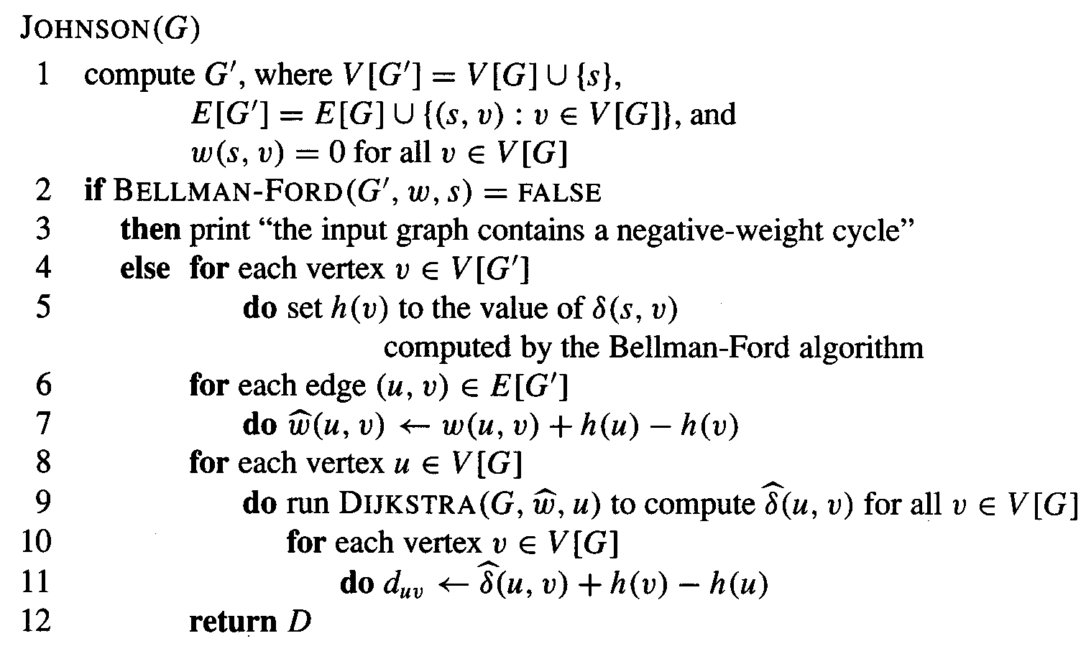
Johnson’s: CLRS

Slide 36
Johnson’s: Running Time
Computing G’: Θ(V)
Bellman-Ford: Θ(VE)
Reweighting: Θ(E)
Running (Modified) Dijkstra: Θ(VElgV)
Adjusting distances: Θ(V²)
—————————————————————
Total Time: Θ(V² +VElgV)

Slide 37
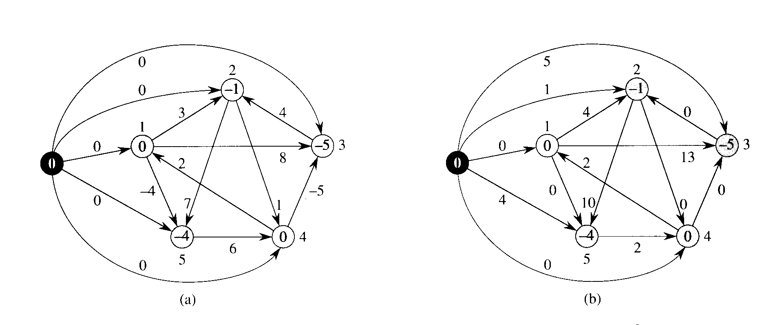
Johnson: reweighting
ŵ(u, v) = w(u, v) + d(s, u) - d(s, v)

Slide 38
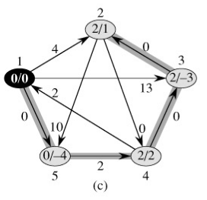
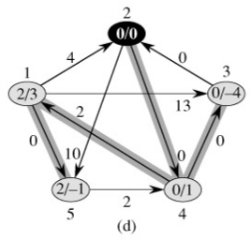
Johnson using Dijkstra

Slide 39
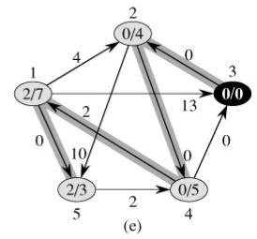
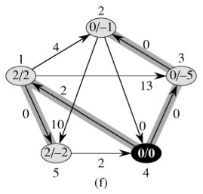
Johnson using Dijkstra

Slide 40
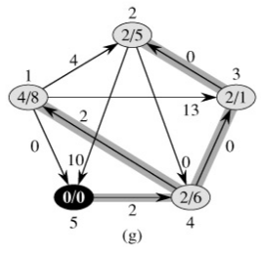
Johnson using Dijkstra

